Slide 1

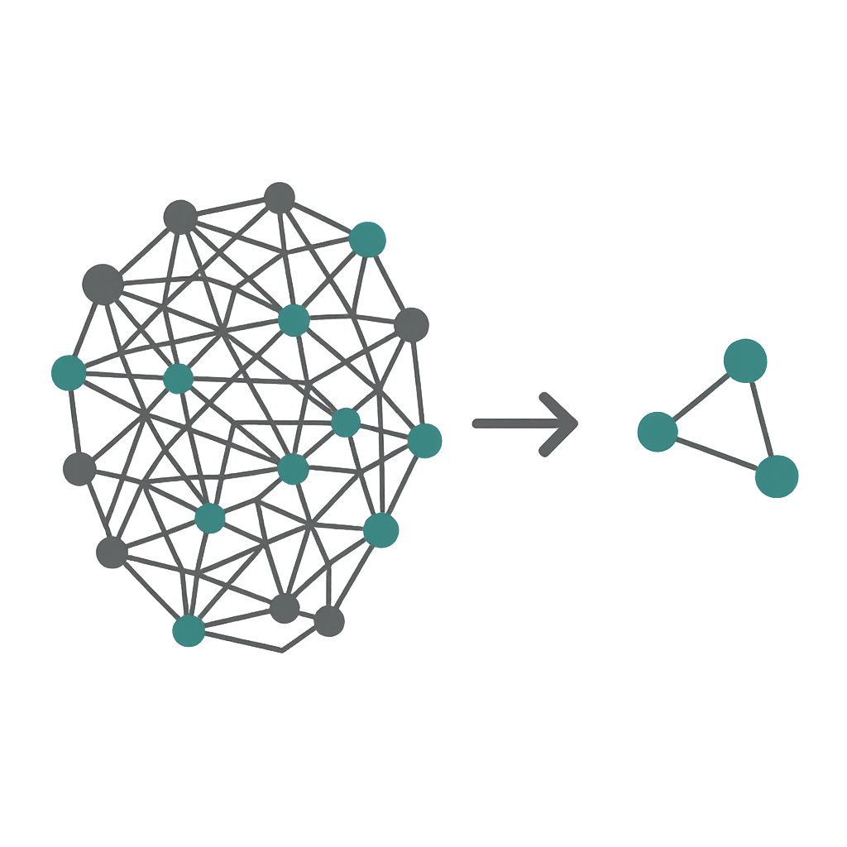
Unsupervised Feature Selection Using Orthogonally Constrained Matrix Factorization with Hessian Regularization and Non-Convex Sparsity
Zubeka Dang¹, Anna Jazayeri¹, Ran Arino¹, Anna Briskina¹, Amir Moslemi^{2,3}
¹Seneca Polytechnic
²Toronto Metropolitan University
³Sunnybrook Research Institute
The 38th Canadian Conference on Artificial Intelligence
May 26-29, 2025
Notes:
Hello everyone
I'm Zubeka Dang, student from Seneca Polytechnic.
I'm presenting our paper 'Unsupervised Feature Selection Using Orthogonally Constrained Matrix Factorization with Hessian Regularization and Non-Convex Sparsity.'

Slide 2
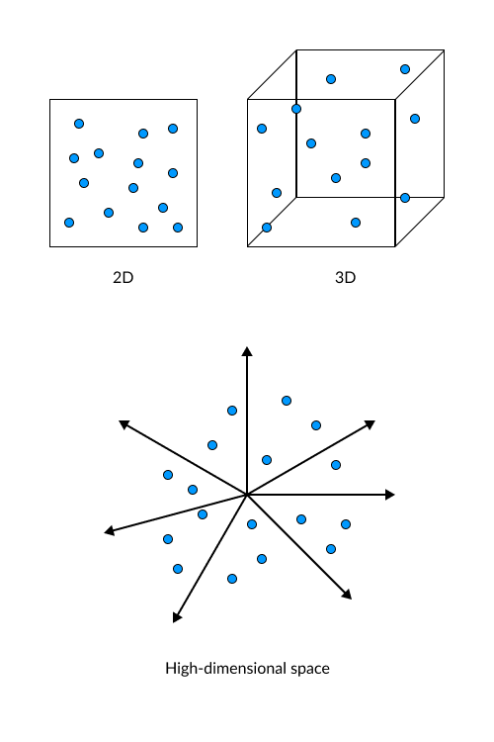
Introduction
Curse of Dimensionality:
Redundancy & Noise: Many features are irrelevant or overlap with others.
Heavy Computation: More features mean slower training and higher resource costs.
Label Scarcity: Supervised methods need labels, but labels are expensive or unavailable.
Lost Geometry: Most existing techniques fail to preserve the data’s true geometric structure
Gap: Need for an unsupervised method that:
Captures local data geometry.
Ensures sparsity and robustness.
Promotes feature independence.
Notes:
In the data explosion era, the curse of dimensionality has become a major issue due to the growing volume and complexity of data.
With High-dimensional datasets, we face a few major issues:
First, many features are irrelevant or overlapping, adding redundancy and noise.
Second, more features mean heavier computational cost—training is slower and resource-hungry.
Third, traditional supervised feature-selection methods depend on labels, yet labels are costly and often unavailable.
Fourth, most existing methods struggle to keep the data’s true geometric structure intact.
As the number of dimensions increases, data points spread out, models overfit to noise, and results become less reliable.
What we need is an unsupervised feature-selection solution that works without labels, removes redundant features, and still understands the underlying structure of the data.

Slide 3
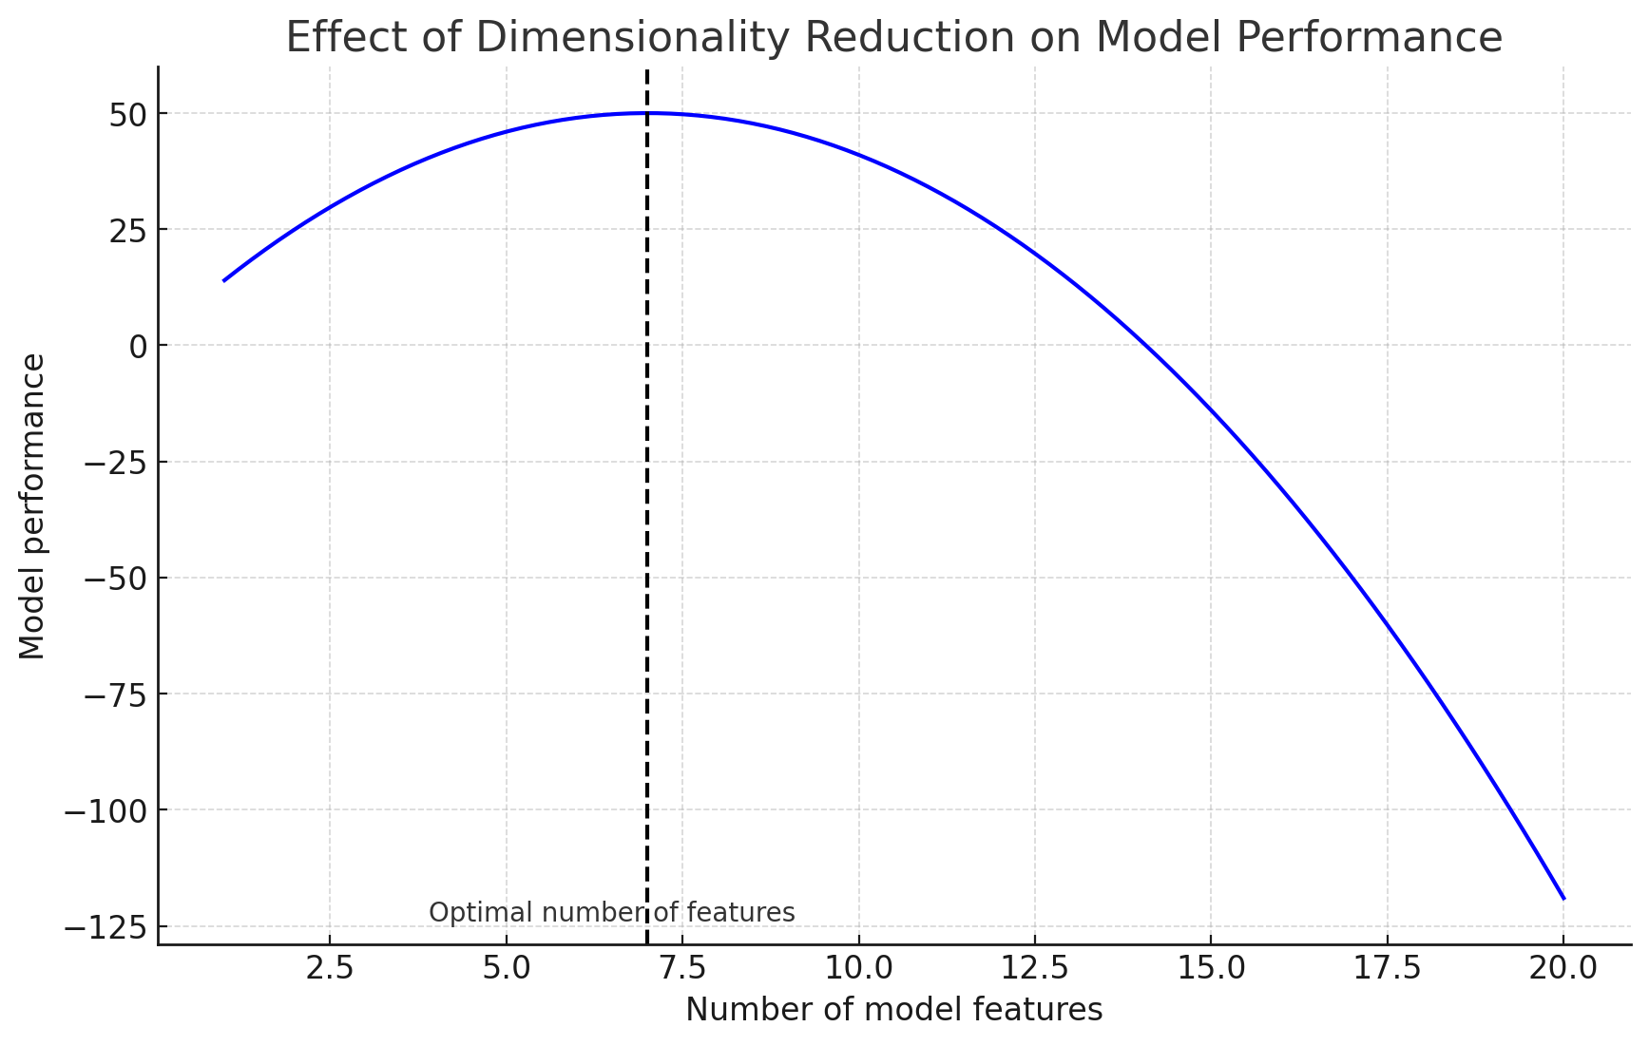
Dimensionality Reduction
Goal: Reduce the number of input variables while preserving relevant information.
Benefits:
Improves model performance.
Reduces computation time and overfitting.
Enhances data visualization.
Types:
Feature Selection: Selects subset of original features.
Feature Extraction: Creates new features.
Notes:
To solve this, we use dimensionality reduction. The idea is keeping only the useful information.
This improves model performance, speeds up training, and even makes data easier to visualize.
We have two main ways to do this: Feature Selection and Feature Extraction.

Slide 4
Dimensionality Reduction Techniques
Feature Selection
Feature Extraction
Filter Methods
Wrapper Methods
Embedded Methods
Linear Techniques
Non-Linear Techniques
Manifold Learning
Matrix Factorization
Variance Threshold
RFE
LASSO (L1 Regularization)
PCA
Kernel PCA
UMAP
SVD
Correlation Coefficient
Sequential Feature Selection
Decision Tree Feature Importance
LDA
t-SNE
Diffusion Maps
NMF
Chi-Square Test
Isomap
Random Forest Feature Importance
Mutual Information
LLE
Laplacian Eigenmaps
Notes:
Feature selection chooses important features from the original data preserve the physical meaning of features for better readability. While Feature extraction creates new features by combining or transforming the originals.
We categorize feature selection strategies into:
Filter Methods: Based on general characteristics, Features ranked based on relevancy and correlation. Such as mutual information learning
Wrapper Methods: Based on predictive model performance, Optimal features are selected iteratively.
With Embedded Methods: Feature selection integrated within model training, using greedy search or regularization
Feature Extraction Strategies contain
Linear Techniques: such as (PCA)
Non-linear techniques: such as Laplacian Eigenmaps
Manifold learning: such as Diffusion Maps
Matrix Factorization: such as SVD

Slide 5
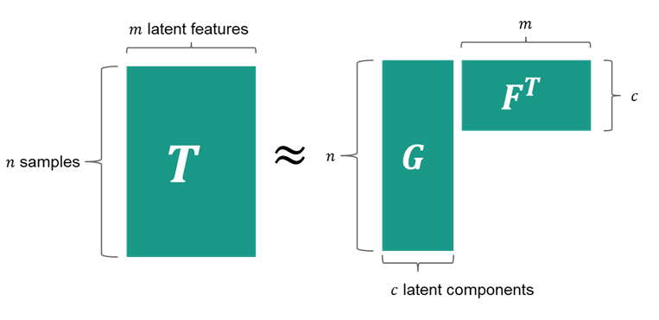
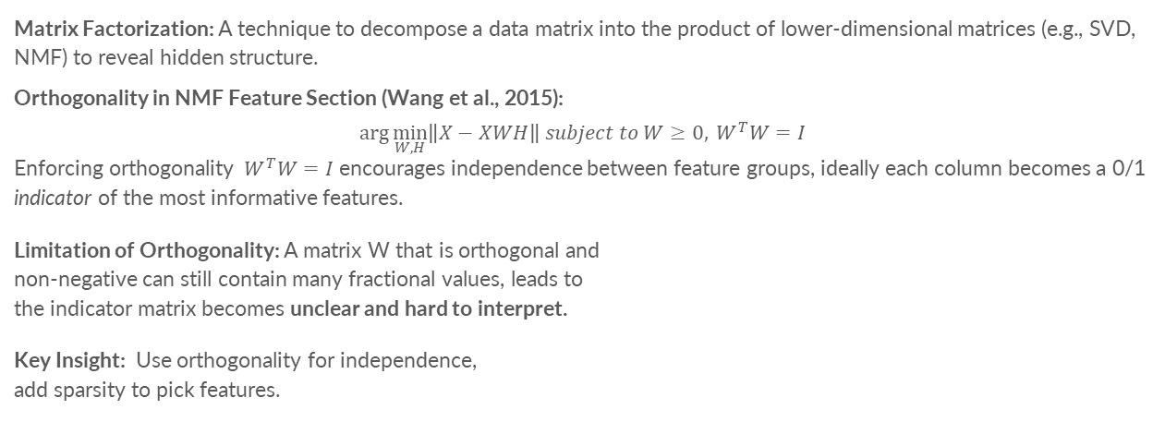
Orthogonality in NMF Feature Section
Matrix Factorization: A technique to decompose a data matrix into the product of lower-dimensional matrices (e.g., SVD, NMF) to reveal hidden structure.
Orthogonality in NMF Feature Section (Wang et al., 2015):
$$\arg{\min_{W,H}\left\|X−XWH\right\| subject to W≥0, { W}^{T}W=I}$$
Enforcing orthogonality ${ W}^{T}W=I$ encourages independence between feature groups, ideally each column becomes a 0/1 indicator of the most informative features.
Limitation of Orthogonality: A matrix W that is orthogonal and non-negative can still contain many fractional values, leads to the indicator matrix becomes unclear and hard to interpret.
Key Insight: Use orthogonality for independence, add sparsity to pick features.
Notes:
Our method builds on Matrix Factorization—a technique that decompose a large data matrix into smaller and simpler ones—using methods like SVD or NMF—to uncover low-dimensional patterns hidden in high-dimensional data.
Non-negative Matrix Factorization learns a weight matrix W. Ideally, if each column of W contains only 0s and 1s, it can clearly indicate which features are most important.
💡 Wang et al., in 2015 proposed Orthogonality Boost in NMF Feature Selection that add the orthogonality constraint on W (WᵀW = I), makes the columns independent, cutting overlap between feature groups.
⚠️ Limitation
Even with orthogonality and non-negativity, the matrix W can still contain many fractional values. As a result, the indicator matrix becomes unclear and hard to interpret.
So, Orthogonality helps reduce feature redundancy, but it is not enough. We still need additional constraints—such as sparsity—to select features more effectively.

Slide 6
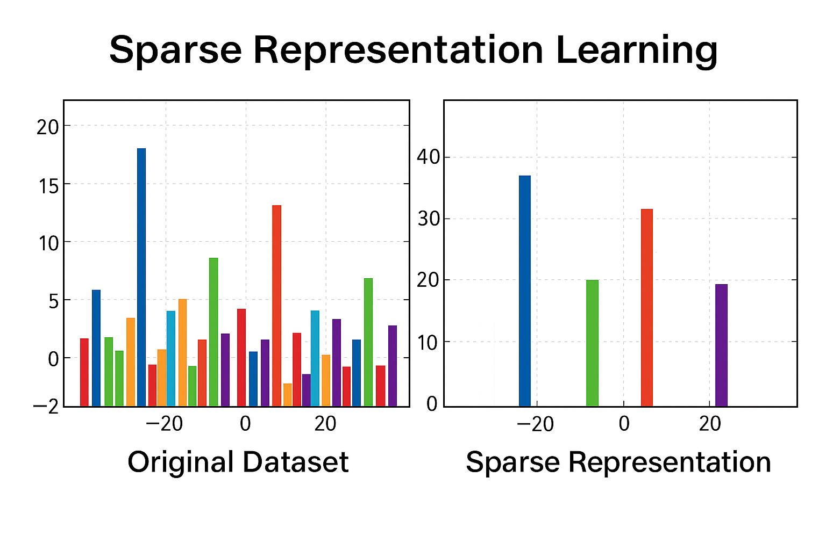
Sparse Representation Learning
Concept:
Sparse signals have only a few nonzero coefficients when represented in a suitable domain
Represent each data point as a sparse linear combination of basis features
Enforces sparsity through regularization terms like ℓ₁-norm to highlight meaningful components
Advantages:
Effectively identify relevant features
Reduce redundancy
Enhance robustness against noise
Notes:
Next is sparse representation. The idea is to use only a few features to represent each data point.
Because most features are noisy or redundant.
Sparse signals are characterized by a few nonzero coefficients in one of their transformation domains.
For example, We enforce a sparsity using an ℓ₁-norm penalty, which drives most coefficients to zero and leaves only the truly informative ones.
By enforcing sparsity, we keep only the useful signals. This helps to handle the outliers and noise existed in the data.

Slide 7
Methodology
Notes:
We’ll now go step by step through the components of our methodology

Slide 8
Notation
Notation | Description
X∈R^{(n×d)} | Data matrix
W∈R^{(d×m)} | Feature selection/projection matrix
T∈R^{(n×m)} | Target matrix
F∈R^{(m×c)} | Basic matrix
G∈R^{(n×c)} | Parameter matrix
H∈R^{(n×n)} | Hessian matrix
Notes:
We define a few key matrices:
X: data matrix
W: projection (feature selection) matrix
T: target matrix
G, F: factorized target matrices
H: Hessian matrix encoding geometry
We’ll see how these interact in the objective.

Slide 9
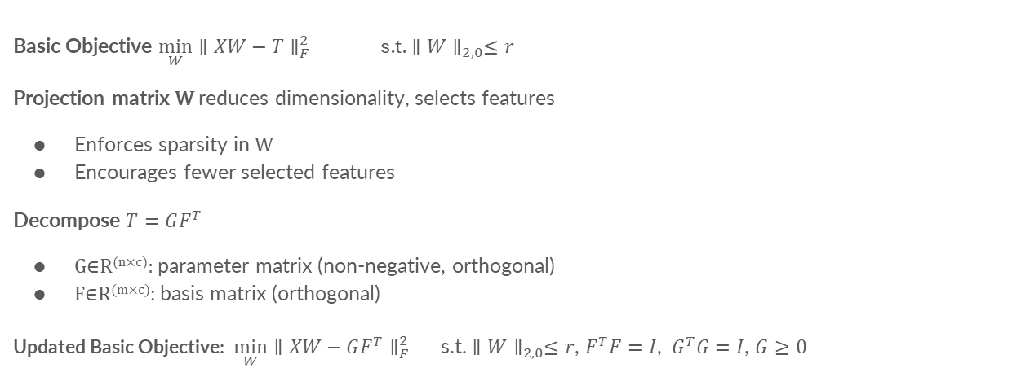
Problem Modelling
Why Decompose the Target Matrix?
Problem with Fixed T: Real-world unsupervised data lacks explicit target matrix
Advantages:
Independent components via F^{T}F=I
Non-negativity in 𝐺 improves interpretability
Encourages part-based, sparse representation
Basic Objective $\min_{W}{∥XW−T∥}_{F}^{2}$ s.t. ${∥W∥}_{2,0}≤r$
Projection matrix W reduces dimensionality, selects features
Enforces sparsity in W
Encourages fewer selected features
Decompose $T=GF^{T}$
G∈R^{(n×c)}: parameter matrix (non-negative, orthogonal)
F∈R^{(m×c)}: basis matrix (orthogonal)
Updated Basic Objective: $\min_{W}{∥XW−GF^{T}∥}_{F}^{2}$ s.t. ${∥W∥}_{2,0}≤r$, $F^{T}F=I$, $G^{T}G=I$, $G≥0$
Notes:
Our goal is to find the projection matrix $W$ that minimizes the distance between projected data $XW$and a target matrix $T$.
Here, the $l_{2,0}$​-norm that enforces sparsity in to encourage fewer selected features
However, in unsupervised learning, labels are not available, so $T$ is unknown,
Thus, we propose using matrix factorization to decompose T into two lower ranked matrices—G and F.
Here, G captures the latent relationships among samples, and F captures latent feature spaces.
Each latent component in G and F is constrained to be orthogonal, ensuring they represent independent, non-redundant features.
The non-negativity constraint in G provides clear interpretability, ensures each latent feature represents distinct groups or clusters.
Overall, it leads to meaningful, robust feature selection.
Notes:
the $l_{2,0}$​-norm that enforces sparsity in $W$ by limiting the number of nonzero rows to $r$number
Why Should GGG Be Non-Negative?
Interpretability:
Non-negative values allow each data point (row in G) to be interpreted as a weighted combination of latent features.
Negative values can cancel or obscure meaning, while non-negativity ensures clearer part-based representations (similar to NMF).
Cluster Membership:
When each row of G contains only positive weights, it can be interpreted as a soft assignment to clusters or components.
This is helpful in unsupervised settings, where cluster-like structures are learned.
Why Should G and F Be Orthogonal?
Independence:
Orthogonality ensures that the learned components (columns of G and F) are independent and non-redundant.
This improves the discriminative power of each component and avoids overlapping information.
Stability:
Orthogonality introduces regularization, stabilizing optimization and avoiding overfitting.
It also helps in reducing correlations among latent features.
Clustering and Feature Selection:
When G is orthogonal, each row emphasizes distinct groups or structures, enhancing interpretability in clustering.
When F is orthogonal, the features selected are less redundant, which is ideal for feature selection.

Slide 10
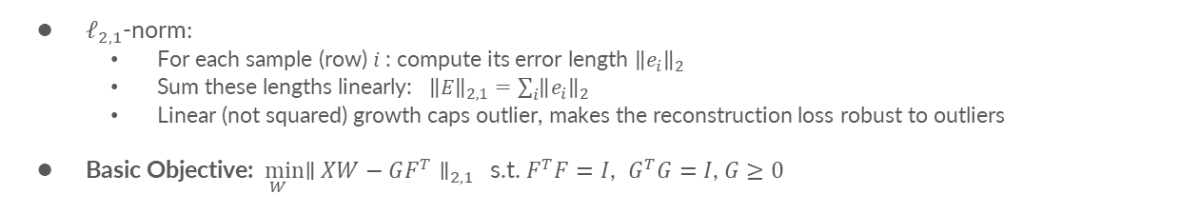
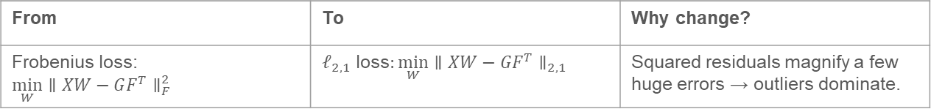
Outlier Resistance
From | To | Why change?
Frobenius loss: $\min_{W}{∥XW−GF^{T}∥}_{F}^{2}$ | $𝓁_{2,1}$​​ loss: $\min_{W}{∥XW−GF^{T}∥}_{2,1}$ | Squared residuals magnify a few huge errors → outliers dominate.
$𝓁_{2,1}$​​-norm:
For each sample (row) 𝑖 : compute its error length ${\left\|e_{i}\right\|}_{2}$
Sum these lengths linearly: ${\left\|E\right\|}_{2,1}=\sum_{i}{{\left\|e_{i}\right\|}_{2}}$
Linear (not squared) growth caps outlier, makes the reconstruction loss robust to outliers
Basic Objective:$\min_{W}{∥XW−GF^{T}∥}_{2,1}$ $​$ s.t. $F^{T}F=I$, $G^{T}G=I$, $G≥0$
Notes:
To handle outliers in the objective, we replace the Frobenius loss with the row-sparse ℓ₂,₁ norm:
Because Frobenius loss squares every residual, so a few huge errors (outliers) dominate the objective.
With ℓ₂,₁ , for each sample we take its residual length (ℓ₂), then add those lengths linearly (ℓ₁).
And linear growth caps outlier influence, keeps the model focused on the clean majority, and yields more stable feature selection.

Slide 11
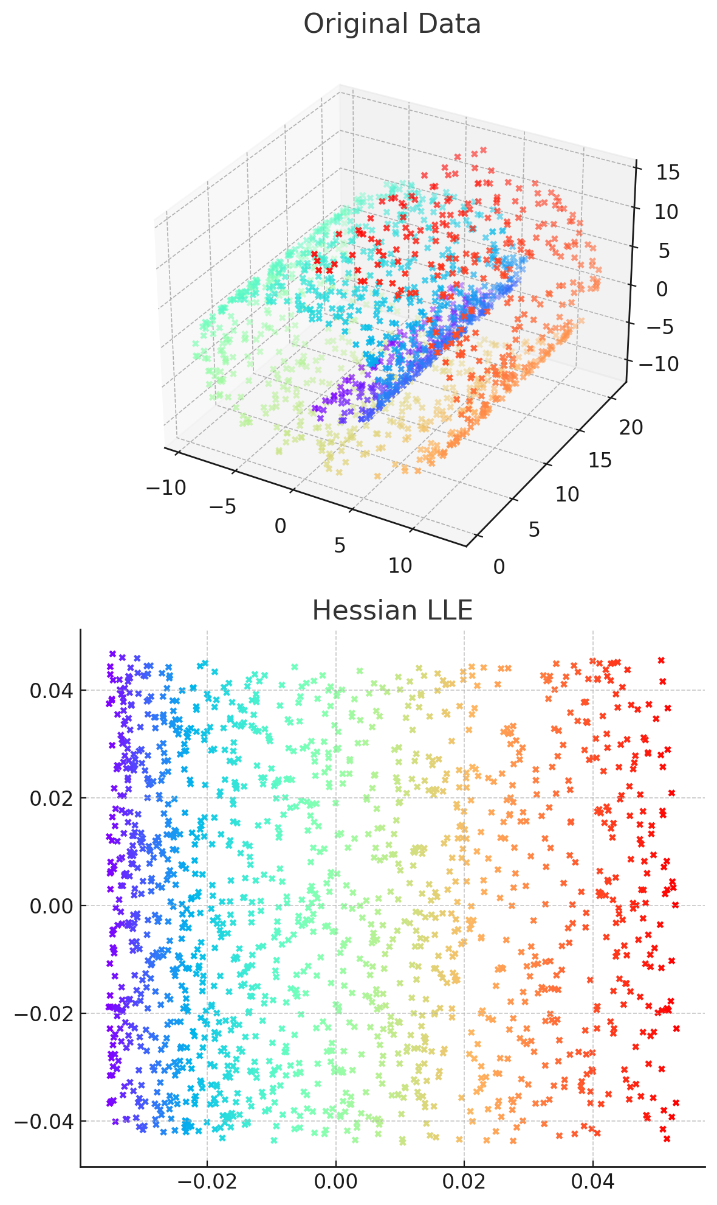
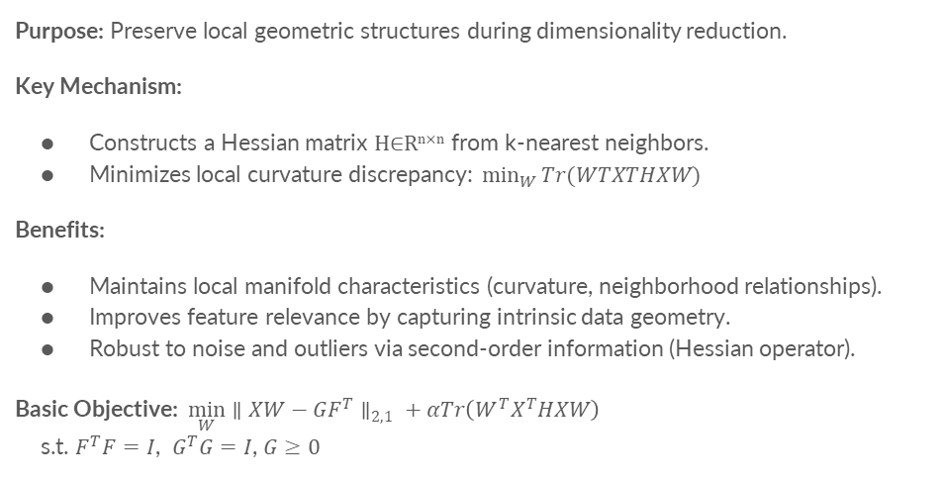
Hessian Regularization
Purpose: Preserve local geometric structures during dimensionality reduction.
Key Mechanism:
Constructs a Hessian matrix H∈R^{n×n} from k-nearest neighbors.
Minimizes local curvature discrepancy: $⁡\min_{W}{Tr(WTXTHXW)}$
Benefits:
Maintains local manifold characteristics (curvature, neighborhood relationships).
Improves feature relevance by capturing intrinsic data geometry.
Robust to noise and outliers via second-order information (Hessian operator).
Basic Objective: $\min_{W}{∥XW−GF^{T}∥}_{2,1} + αTr\left(W^{T}X^{T}HXW\right)$
$\text{s}\text{.}\text{t}\text{. }F^{T}F=I\text{, }G^{T}G=I\text{,}$ $G≥0$
Notes:
One of the biggest problems with projection or dimensionality reduction methods is that we might lose the data’s intrinsic geometry. If two samples are close in the original high-dimensional space, their relative shape and distance should remain the same after projection.
To preserve this structure, we apply a structure-learning optimization.
A common choice is Laplacian regularization: by connecting nearby samples in a graph and penalizing large differences between neighbors, it preserves first-order and edge-length geometry.
However, the Laplacian has two limitations. First, it assume straight-line (geodesic) distances, ignoring manifold curvature. Second, its null space contains only constant functions, so it cannot capture the sudden bends or twists often seen in real data.
To overcome these issues, we use Hessian regularization instead. By considering second-order information—local curvature—the Hessian discourages sharp twists and better preserves the manifold’s true geometry, leading to more reliable feature selection.

Slide 12
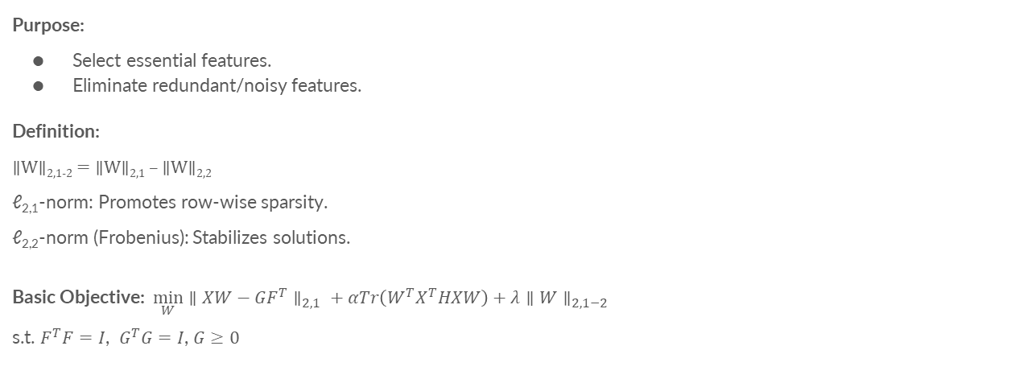
Sparsity Regularization – ℓ_{2,1−2}-norm
Purpose:
Select essential features.
Eliminate redundant/noisy features.
Definition:
∥W∥_{2,1-2} = ∥W∥_{2,1} – ∥W∥_{2,2}
ℓ_{2,1}-norm: Promotes row-wise sparsity.
ℓ_{2,2}-norm (Frobenius): Stabilizes solutions.
Basic Objective: $\min_{W}{∥XW−GF^{T}∥}_{2,1} + αTr\left(W^{T}X^{T}HXW\right)+λ{∥W∥}_{2,1−2}$
$\text{s}\text{.}\text{t}\text{. }F^{T}F=I\text{,} G^{T}G=I\text{,}$ $G≥0$
Notes:
To enforce sparsity, the $l_{2,p}$​​-quasi-norm with p in between 0 and 1, is often used. However, $l_{2,p}$-norm is non-convex, and not Lipschitz-continuous at the origin, which makes global minimization difficult.
Instead, we use the $l_{2,1−2}$​-norm. It’s the difference between the $l_{2,1}$​-norm which promotes sparsity and Frobenius norm that preserves magnitude.
Although $l_{2,1−2}$​-norm is still non-convex, it’s Lipschitz-continuous; allowing stable gradient-based updates. And giving a stronger group-sparsity than ℓ2,1-norm alone.

Slide 13
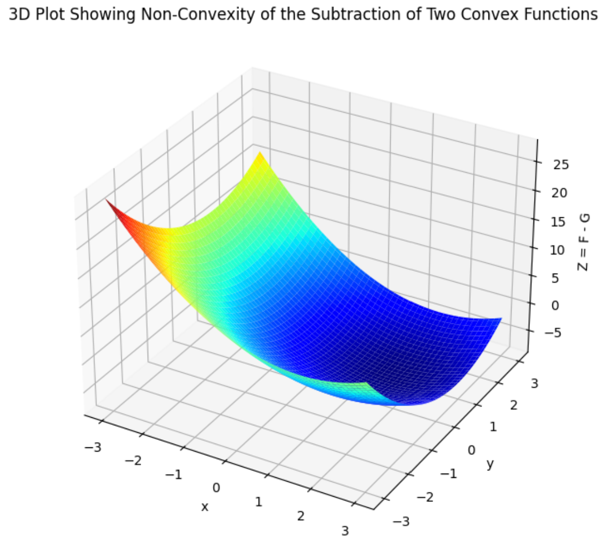
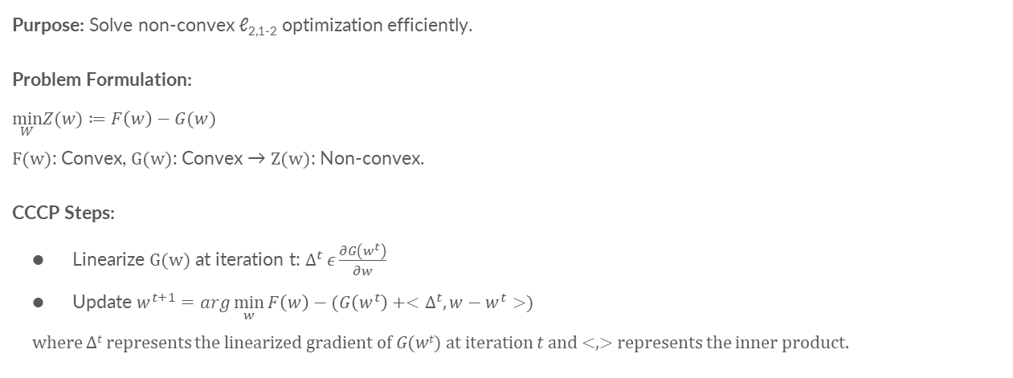
Concave-Convex Procedure (CCCP) Optimization
Purpose: Solve non-convex ℓ_{2,1-2} optimization efficiently.
Problem Formulation:
$$\min_{W}Z(w)≔F\left(w\right)−G(w)$$
F(w): Convex, G(w): Convex → Z(w): Non-convex.
CCCP Steps:
Linearize G(w) at iteration t: $∆^{t} ε\frac{∂G\left(w^{t}\right)}{∂w}$
Update $w^{t+1}=arg\min_{w}{F\left(w\right)−(G\left(w^{t}\right)+<∆^{t},w−w^{t}>)}$
where ∆^{𝑡} represents the linearized gradient of 𝐺(𝑤^{𝑡}) at iteration 𝑡 and <,> represents the inner product.
Notes:
To handle the non-convexity of $l_{2,1−2}$​-norm, we use the Concave-Convex Procedure (CCCP).
This method breaks a non-convex problem into convex and concave parts and solves it iteratively.
In general, $F\left(w\right)$ and $G\left(w\right)$ are two convex functions, but their difference Z is non-convex.
$Z\left(w\right)$ remains nonconvex unless $G(w)$ is affine. To address this, CCCP approximates $G(w)$ with its linearized form, converting the original problem into a sequence of convex optimization steps.

Slide 14
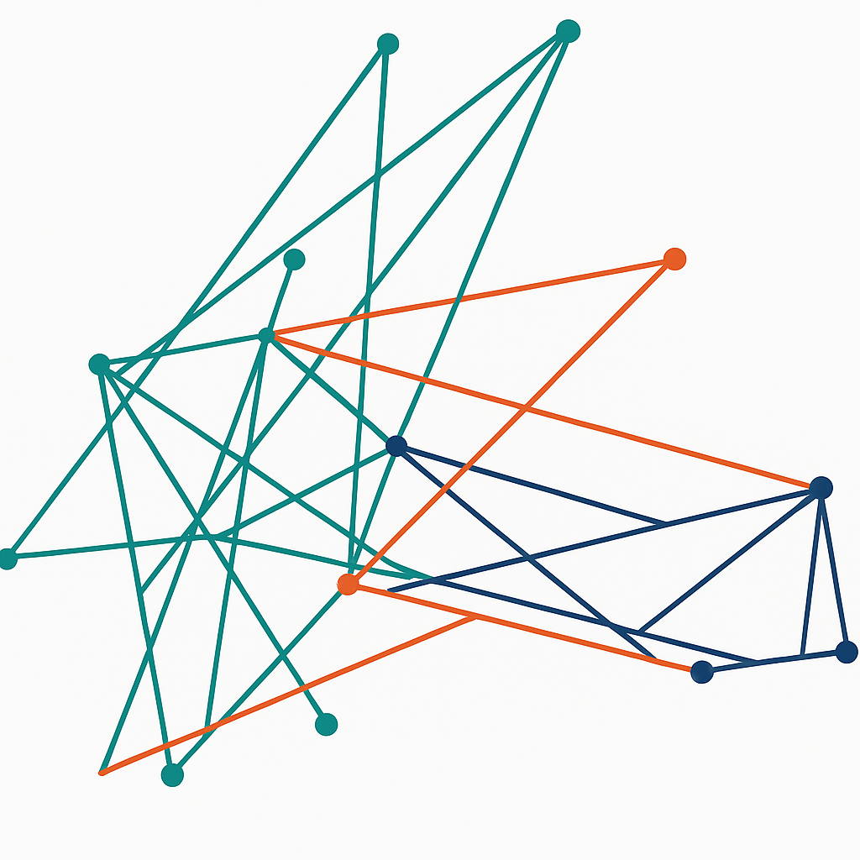
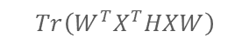
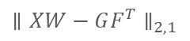
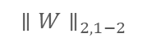
Objective Function
$\min_{W,G,F}{∥XW−GF^{T}∥}_{2,1} + αTr\left(W^{T}X^{T}HXW\right)+λ{∥W∥}_{2,1−2}$ s.t. $F^{T}F=I$, $G^{T}G=I$, $G≥0$
$${∥W∥}_{2,1−2}$$
$${∥XW−GF^{T}∥}_{2,1}$$
$$Tr\left(W^{T}X^{T}HXW\right)$$
Sparse Penalty
Reconstruction Loss
Structure Learning
Notes:
Our full objective includes:
A reconstruction loss between $XW$ and $GF^{T}$
Hessian regularization to preserve geometry
$l_{2,1−2}$norm for sparsity
Orthogonality removes redundant features and keeps latent components independent
Non-negativity on G promotes data representation interpretable

Slide 15
Optimizing the Objective Function
Goal: Minimize the objective function with respect to projection matrix W
Challenges:
Non-smooth ℓ_{2,1}-norm hinders gradient-based optimization
Interdependence of variables W, G, and F in reconstruction term
Constraints: F^{T}F = I, G^{T}G = I, G ≥ 0
Solution: Reformulate using auxiliary variables:
E = XW – GF^{T}
K = G with K ≥ 0
Notes:
Optimizing this objective is tricky:
The ℓ2,1-norm is non-smooth hinders gradient-based optimization
Variables W, G, and F are interdependent
Orthogonality and non-negativity add further complexity
So, we reformulate the problem using auxiliary variables $E$ and $K$.
The reconstruction error variable 𝐸 to represent the discrepancy between $XW$ and $GF^{T}$.
This method separates from the interdependence of 𝑊, 𝐺, and 𝐹, simplifying the optimization of 𝑊.
The decouple variable 𝐾 to decouple the non-negativity constraint of 𝐺 from the orthogonality constraint of $G$, we set 𝐾 = 𝐺 with K is non-negativity

Slide 16
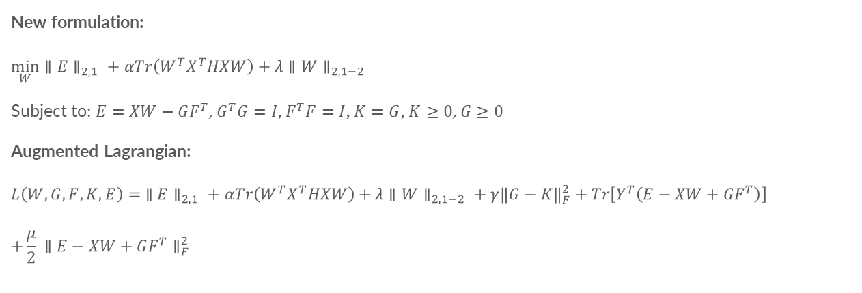
Reformulated Objective Function
New formulation:
$$\min_{W}{∥E∥}_{2,1} + αTr\left(W^{T}X^{T}HXW\right)+λ{∥W∥}_{2,1−2}$$
Subject to: $E=XW−GF^{T}$, $G^{T}G=I$, $F^{T}F=I$, $K=G$, $K≥0$, $G≥0$
Augmented Lagrangian:
$$L\left(W,G,F,K,E\right)= {∥E∥}_{2,1}​+αTr\left(W^{T}X^{T}HXW\right)+λ{∥W∥}_{2,1−2}​+γ{\left\|G−K\right\|}_{F}^{2}​+Tr\left[Y^{T}\left(E−XW+GF^{T}\right)\right]$$
$$+\frac{μ}{2}​{∥E−XW+GF^{T}∥}_{F}^{2}​$$
Notes:
With the Reformulated Objective Function, We now express the constraints using Lagrangian terms and penalty parameters.
The technique Augmented Lagrangian optimization blends penalty methods with Lagrange multipliers to handle complex constraints effectively.

Slide 17
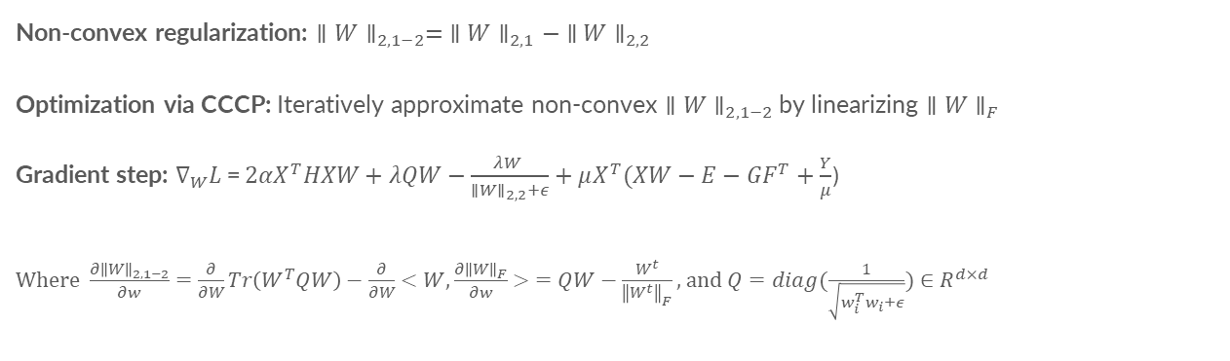
Update W with CCCP
Non-convex regularization: ${∥W∥}_{2,1−2}= {∥W∥}_{2,1}− {∥W∥}_{2,2}$
Optimization via CCCP: Iteratively approximate non-convex ${∥W∥}_{2,1−2}$ by linearizing ${∥W∥}_{F}$
Gradient step: $∇_{W}L$= $2{αX}^{T}HXW+λQW−\frac{λW }{{∥W∥}_{2,2}+ε}+μX^{T}(XW−E−GF^{T}+\frac{Y}{μ}$)
Where $\frac{∂{\left\|W\right\|}_{2,1−2}}{∂w}=\frac{∂}{∂W}Tr\left(W^{T}QW\right)−\frac{∂}{∂W}<W,\frac{∂{\left\|W\right\|}_{F}}{∂w}> =QW−\frac{W^{t}}{{\left\|W^{t}\right\|}_{F}}$ , and $Q=diag(\frac{1}{\sqrt{w_{i}^{T}w_{i}+ε}})∈R^{d×d}$
Notes:
We update W using a gradient-based method to minimize the objective function with respect to the projection matrix $W$ while keeping other variables fixed.
The method incorporates:
Hessian structure
Sparse regularization (ℓ2,1−2)
Constraint penalties
CCCP handles the non-convex part by Linearising the concave part - Frobenius norm of W ( ${∥W∥}_{F})$, giving us a reliable update.
$\frac{∂{\left\|W\right\|}_{2,1−2}}{∂w}=\frac{∂}{∂W}Tr\left(W^{T}QW\right)−\frac{∂}{∂W}<W,\frac{∂{\left\|W\right\|}_{F}}{∂w}> =QW−\frac{W^{t}}{{\left\|W^{t}\right\|}_{F}}$
where $Q=diag(\frac{1}{\sqrt{w_{i}^{T}w_{i}+ε}})∈R^{d×d}$is a diagonal matrix, and $ε$ is a small positive constant to ensure numerical stability and handle the case when ${\left\|w_{i}\right\|}_{2}=0$.

Slide 18
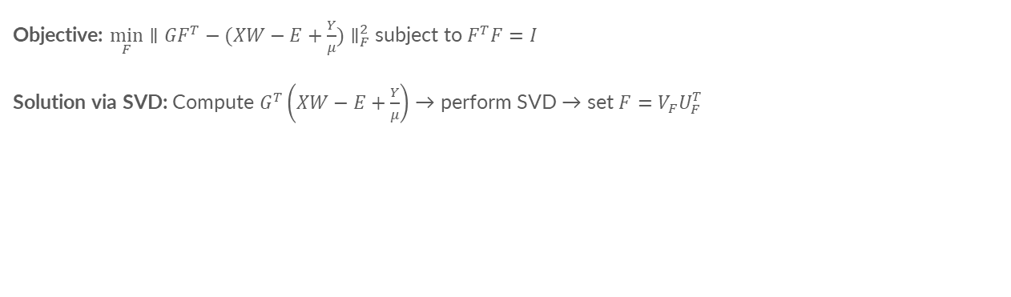
Update F
Objective: $\min_{F}{{∥GF^{T}−(XW−E+\frac{Y}{μ})∥}_{F}^{2}}$subject to $F^{T}F=I$
Solution via SVD: Compute $G^{T}\left(XW−E+\frac{Y}{μ}\right)$ → perform SVD → set $F=V_{F}U_{F}^{T}$
Notes:
To update F, we solve a constrained minimization with orthogonality. We use SVD to ensure that F remains orthogonal, which helps maintain independent latent directions.

Slide 19
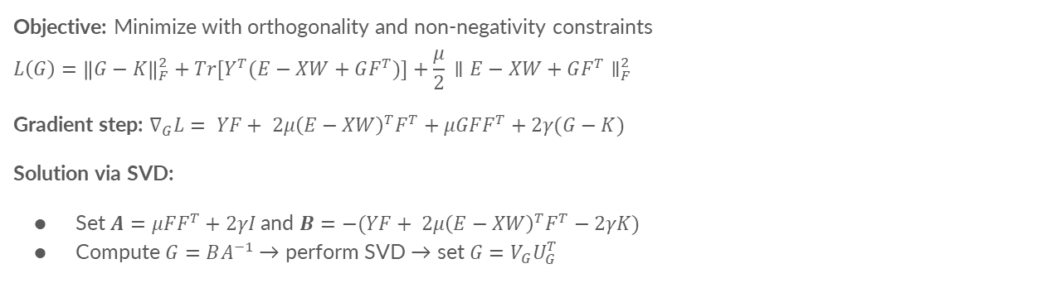
Update G
Objective: Minimize with orthogonality and non-negativity constraints
$$L\left(G\right)={\left\|G−K\right\|}_{F}^{2}​+Tr[Y^{T}(E−XW+GF^{T})]+\frac{μ}{2}​{∥E−XW+GF^{T}∥}_{F}^{2}$$
Gradient step: $∇_{G}L= YF+ 2μ{\left(E−XW\right)}^{T}F^{T}+μGFF^{T}+2γ(G−K)$
Solution via SVD:
Set $A=μFF^{T}+2γI$and $B=−(YF+ 2μ{\left(E−XW\right)}^{T}F^{T}−2γK)$
Compute $G=BA^{−1}$→ perform SVD → set $G=V_{G}U_{G}^{T}$
Notes:
Next, we update G while enforcing:
Non-negativity and Orthogonality
This is done through a combination of matrix inversion and another SVD step to restore constraints.

Slide 20
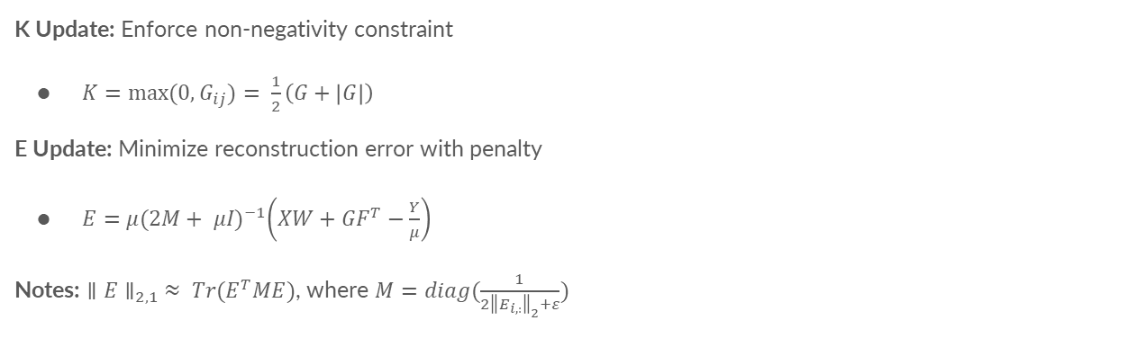
Update K and E
K Update: Enforce non-negativity constraint
$K=max⁡(0,G_{ij})= \frac{1}{2}\left(G+\left|G\right|\right)$
E Update: Minimize reconstruction error with penalty
$E=μ{(2M+ μI)}^{−1}\left(XW+GF^{T}−\frac{Y}{μ}\right)$
Notes: ${∥E∥}_{2,1} ≈ Tr(E^{T}ME)$, where $M=diag(\frac{1}{2{\left\|E_{i,:}\right\|}_{2}+ε})$
Notes:
K is an auxiliary variable that decouples constraints on $G$.
We update $K$ by projecting $G$ to the non-negative space.
The reconstruction error $E$ is updated by solving a quadratic minimization involving the Hessian-based structure.

Slide 21
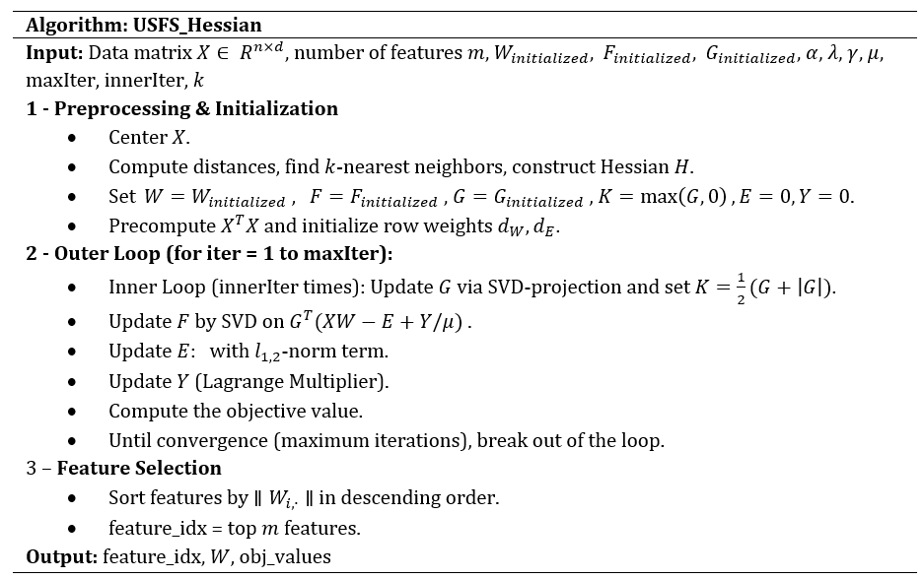
Summary of Optimization
Iterative updates for each variable:
Alternate updates of W, F, G, K, E
Techniques used:
CCCP for non-convex sparsity
Augmented Lagrangian for constraint handling
SVD for enforcing orthogonality
Result: Effective feature selection that preserves data structure
Notes:
To summarize: We alternate updates of $W, G, F, E$, and $K$ until convergence. We use:
CCCP for sparsity
Augmented Lagrangian to handle constraints
SVD to enforce orthogonality
After convergence, we rank features by the ℓ₂-norm of each row in W in descending order and select the top ones. This ensures the most informative features are preserved.

Slide 22
Experiments and Results

Slide 23
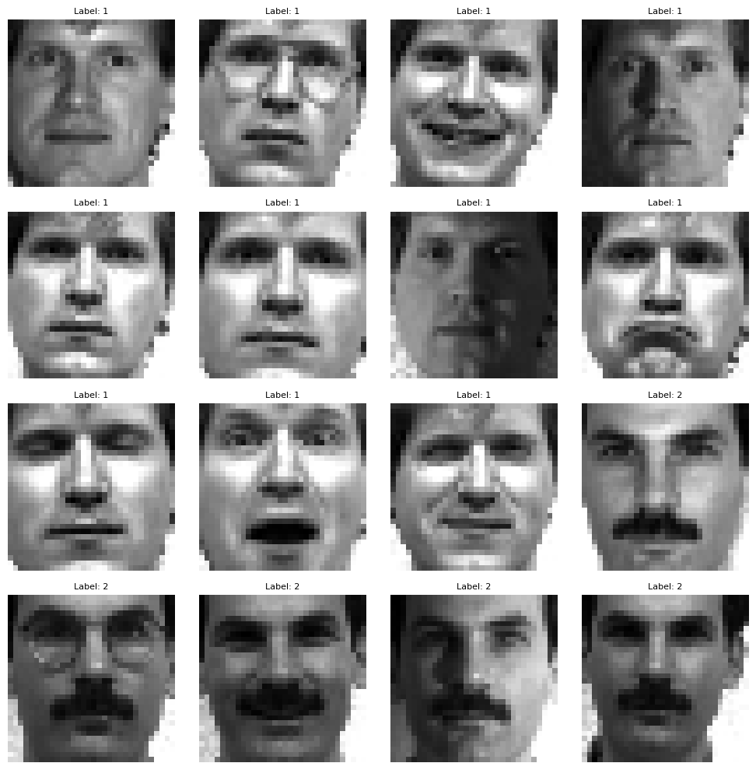
Experiment Setup
Datasets:
10 diverse datasets (e.g., Colon, GLI-85, ORL, Yale).
High-dimensional (up to 22,283 features) with limited labels.
Baselines:
NDFS, AEFS, UFGOR, NMF, RNMF.
Metrics:
Clustering Accuracy, Normalized Mutual Information (NMI).
Sample images from the Yale dataset.
Notes:
We tested our method on 10 different high-dimensional datasets from various domains, comparing our method against several well-known techniques.
We evaluated our method using two key metrics:
Clustering Accuracy measures how accurately data points were grouped into their correct clusters.
Normalized Mutual Information (NMI) measures clustering quality by checking how similar the predicted clusters are to the true clusters, regardless of label names.
We used Bayesian Optimization to tune our hyperparameters, then selected the top 50 features, and tested clustering performance on these features.

Slide 24
Results
Dataset | Baseline | NDFS | AEFS | UFGOR | NMF | RNMF | Proposed Method
ORL | 48±3 | 50±3 | 51±3 | 50±3 | 50±2 | 51±4 | 52±3
Yale | 38±3 | 46±4 | 44±4 | 43±3 | 43±5 | 45±4 | 46±5
warpPIE10P | 26±2 | 49±4 | 50±5 | 42±5 | 42±6 | 47±6 | 51±7
Jaffe | 69±3 | 73±5 | 74±7 | 75±7 | 71±8 | 74±6 | 76±7
TOX_171 | 40±2 | 49±3 | 48±2 | 50±1 | 45±2 | 48±1 | 50±2
Lymphoma | 45±3 | 55±6 | 54±4 | 57±5 | 52±4 | 55±7 | 56±4
Colon | 44±3 | 53±4 | 52±3 | 53±3 | 52±2 | 54±4 | 56±5
Prostate | 37±3 | 42±3 | 43±4 | 43±2 | 42±3 | 41±4 | 43±4
GLI-85 | 68±2 | 74±4 | 76±2 | 77±2 | 77±4 | 76±5 | 78±3
Leukemia | 65±4 | 74±5 | 76±7 | 76±4 | 75±5 | 75±7 | 78±6
Dataset | Baseline | NDFS | AEFS | UFGOR | NMF | RNMF | Proposed Method
ORL | 58±5 | 74±3 | 75±3 | 73±4 | 73±5 | 73±3 | 77±4
Yale | 33±4 | 52±5 | 52±4 | 53±4 | 52±3 | 52±3 | 53±5
warpPIE10P | 28±6 | 41±3 | 46±3 | 45±6 | 43±3 | 43±3 | 47±5
Jaffe | 69±4 | 80±4 | 86±4 | 83±4 | 81±4 | 81±4 | 88±6
TOX_171 | 16±4 | 24±4 | 24±4 | 21±3 | 20±3 | 22±4 | 25±5
Lymphoma | 51±5 | 63±4 | 66±5 | 67±3 | 65±2 | 66±4 | 68±6
Colon | 7±2 | 28±2 | 26±3 | 21±3 | 14±2 | 16±2 | 21±3
Prostate | 9±3 | 13±3 | 12±3 | 11±3 | 13±2 | 13±3 | 14±3
GLI-85 | 5±3 | 48±5 | 46±5 | 42±2 | 39±2 | 41±4 | 48±5
Leukemia | 11±5 | 15±4 | 14±3 | 12±2 | 12±3 | 13±4 | 16±3
Table 1. Clustering Accuracy (Top 50 Features)
Table 2. Normalized Mutual Information (NMI)
Notes:
Our method consistently outperformed others in both accuracy and NMI, showing robust feature selection even with fewer features.

Slide 25
Conclusion & Future Work
Conclusion:
Unified framework for unsupervised feature selection with improved clustering performance.
Robust to noise and redundancy in high-dimensional data.
Future Work:
Extend to dynamic datasets.
Explore applications in real-time systems.
Notes:
To conclude, our proposed method effectively addresses the challenges of unsupervised feature selection, achieving robust, interpretable, and efficient dimensionality reduction.
In the future, we aim to extend this method to dynamic and real-time datasets, particularly in healthcare and bioinformatics.

Slide 26
References
[1] Moslemi, A. (2023). Sparse representation learning using ℓ₁−₂ compressed sensing and rank-revealing QR factorization. Engineering Applications of Artificial Intelligence, 125, 106663.
[2] Moslemi, A. (2024). Regularization Functions in Subspace Learning-based Feature Selection: Tutorial. hal-04733334. HAL Science.
[3] Moslemi, A., & Ahmadian, A. (2024). Subspace learning for feature selection via rank revealing QR factorization: Fast feature selection. Expert Systems with Applications, 256, 124919.
[4] Moslemi, A., & Shaygani, A. (2024). Subspace learning via Hessian regularized latent representation learning with ℓ₂,₀-norm constraint: Unsupervised feature selection. International Journal of Machine Learning and Cybernetics.
[5] Moslemi, A., Bidar, M., & Ahmadian, A. (2023). Subspace learning using structure learning and non-convex regularization: Hybrid technique with mushroom reproduction optimization in gene selection. Computers in Biology and Medicine, 164, 107309.
[6] Luo, C., Zheng, J., Li, T., Chen, H., Huang, Y., & Peng, X. (2022). Orthogonally constrained matrix factorization for robust unsupervised feature selection with local preserving. Information Sciences, 586, 662–675.
[7] Cai, D., Zhang, C., & He, X. (2010). Unsupervised feature selection for multi-cluster data. Proceedings of the 16th ACM SIGKDD International Conference on Knowledge Discovery and Data Mining, 333–342.
[8] Nie, F., Zhu, W., & Li, X. (2016). Unsupervised feature selection with structured graph optimization. Proceedings of the 30th AAAI Conference on Artificial Intelligence, 1302–1308.
[9] Nie, F., Dong, X., Tian, L., Wang, R., & Li, X. (2020). Unsupervised feature selection with constrained ℓ₂,₀-norm and optimized graph. IEEE Transactions on Neural Networks and Learning Systems, 33(4), 1702–1713.
[10] Saberi-Movahed, F., Eftekhar, M., & Mohtashami, M. (2020). Supervised feature selection by constituting a basis for the original space of features and matrix factorization. International Journal of Machine Learning and Cybernetics, 11, 1405–1421.
[11] Han, K., Wang, Y., Zhang, C., Li, C., & Xu, C. (2018). Autoencoder inspired unsupervised feature selection. IEEE International Conference on Acoustics, Speech and Signal Processing (ICASSP), 2941–2945.
[12] Kim, K. I., Steinke, F., & Hein, M. (2009). Semi-supervised regression using Hessian energy with an application to semi-supervised dimensionality reduction. Advances in Neural Information Processing Systems 22.
[13] Shang, R., Xu, K., & Jiao, L. (2020). Subspace learning for unsupervised feature selection via adaptive structure learning and rank approximation. Neurocomputing, 413, 72–84.
[14] Sheikhpour, R., Berahmand, K., & Forouzandeh, S. (2023). Hessian-based semi-supervised feature selection using generalized uncorrelated constraint. Knowledge-Based Systems, 269, 110521.
[15] Jahani, M. S., Aghamollaei, G., Eftekhari, M., & Saberi-Movahed, F. (2023). Unsupervised feature selection guided by orthogonal representation of feature space. Neurocomputing, 516, 61–76.
[16] Solorio-Fernandez, S., Ariel, C. J., & Martinez-Trinidad, J. F. (2020). A review of unsupervised feature selection methods. Artificial Intelligence Review, 53(2), 907–948.
[17] Solorio-Fernandez, S., Ariel, C. J., & Martinez-Trinidad, J. F. (2022). A survey on feature selection methods for mixed data. Artificial Intelligence Review, 55(4), 2821–2846.
[18] Wang, S., Pedrycz, W., Zhu, Q., & Zhu, W. (2015). Subspace learning for unsupervised feature selection via matrix factorization. Pattern Recognition, 48(1), 10–19.
[19] Wang, S., Chen, J., Guo, W., & Liu, G. (2020). Structured learning for unsupervised feature selection with high-order matrix factorization. Expert Systems with Applications, 140, 112878.
[20] Zhou, S., Song, P., Song, Z., & Ji, L. (2023). Soft-label guided non-negative matrix factorization for unsupervised feature selection. Expert Systems with Applications, 216, 119468.
[21] Shi, Y., Miao, J., Wang, Z., Zhang, P., & Niu, L. (2018). Feature selection with ℓ₂,₁−₂ regularization. IEEE Transactions on Neural Networks and Learning Systems, 29(10), 4967–4982.
[22] Yang, Y., Shen, H., Ma, Z., Huang, Z., & Zhou, X. (2012). ℓ₂,₁-norm regularized discriminative feature selection for unsupervised learning. Proceedings of the 22nd International Joint Conference on Artificial Intelligence, 1589–1594.
[23] Li, Z., Yang, Y., Liu, J., Zhou, X., & Lu, H. (2012). Unsupervised feature selection using nonnegative spectral analysis. Proceedings of the 26th AAAI Conference on Artificial Intelligence, 1026–1032.
[24] D.L. Donoho, & C. Grimes, Hessian eigenmaps: Locally linear embedding techniques for high-dimensional data, Proc. Natl. Acad. Sci. U.S.A. 100 (10) 5591-5596, https://doi.org/10.1073/pnas.1031596100 (2003).
[25] Moslemi, A. (2023). A tutorial-based survey on feature selection: Recent advancements on feature selection. Engineering Applications of Artificial Intelligence, 126, 107136-.
Notes:
We’d like to acknowledge key references that guided this work, especially contributions on matrix factorization, sparse learning, and manifold-based optimization.

Slide 27

Q&A
Contact: zddang@myseneca.ca
Thank you!
Notes:
Thank you so much for your attention. I’m happy to take any questions!

